Slide 1
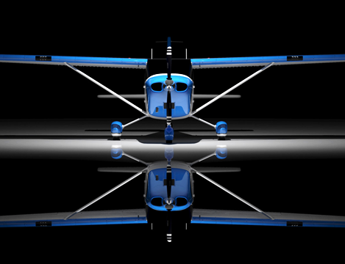
VICTORIA FLYING CLUB
AIRFRAMES AND ENGINES

Slide 2
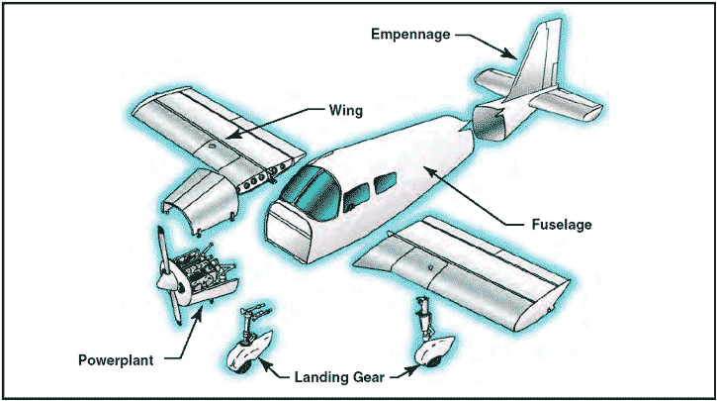
AIRCRAFT COMPONENTS
MATERIALS NEED TO BE LIGHT, WITHSTAND STRESSES AND BE CORROSION-RESISTANT

Slide 3
TYPES OF CONSTRUCTION
WOOD
LIGHT AND EASY TO WORK WITH.
IT HAS BEEN WIDELY USED IN AIRFRAME
AND WING CONSTRUCTION.
IT CAN BE USED AS A COVERING TO
PROVIDE A SMOOTH FINISH.

Slide 4
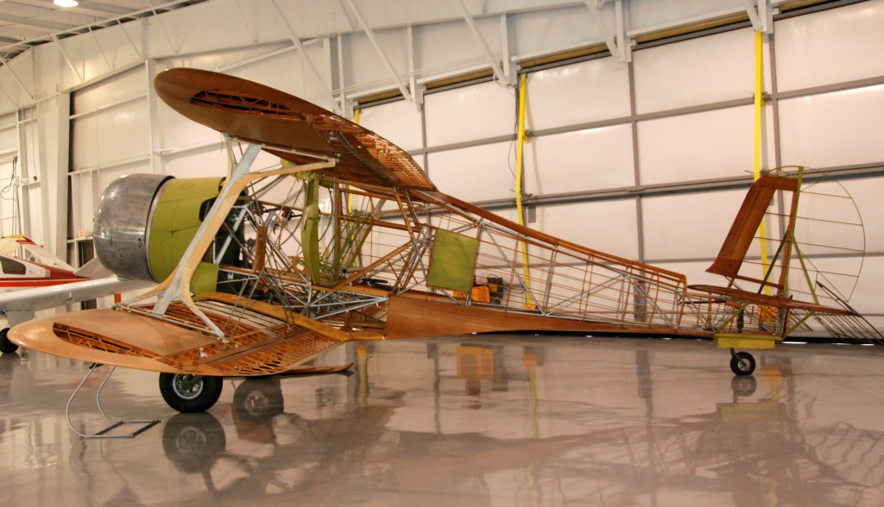
TYPES OF CONSTRUCTION
BEECHCRAFT E17B
WOOD

Slide 5
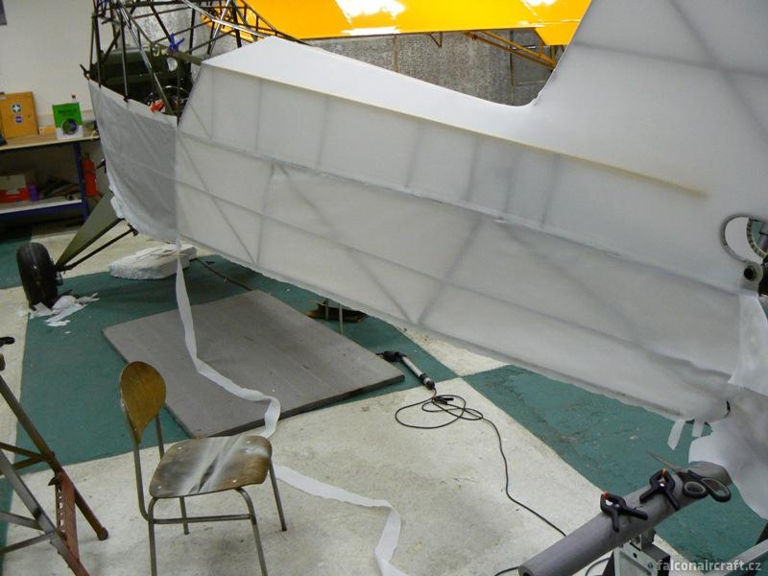
TYPES OF CONSTRUCTION
FABRIC
AIRFRAMES, WINGS AND CONTROL SURFACES, CAN BE COVERED WITH COTTON, LINEN, OR SYNTHETIC FIBERS.
THE FABRIC IS DRAWN TIGHT USING A FABRIC VARNISH (COTTON OR LINEN) OR BY SHRINKING USING A HOT IRON (DACRON, STITS, CECONITE)

Slide 6
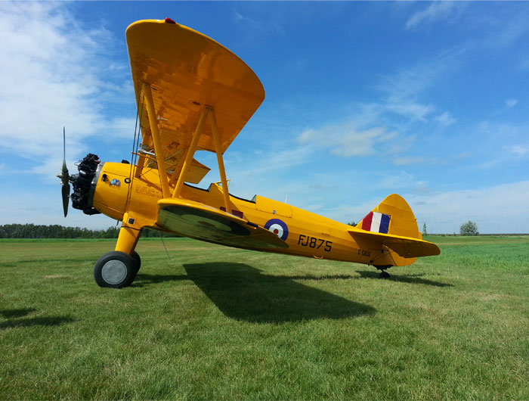
TYPES OF CONSTRUCTION
FABRIC
BOEING PT-17

Slide 7
TYPES OF CONSTRUCTION
STEEL ALLOY
STRONG AND RESISTANT TO IMPACT AND VIBRATION, USED IN TUBULAR AIRFRAME AND WING CONSTRUCTION.
ALLOY CONTAINING NICKEL (STAINLESS STEEL)
IS HIGHLY RESISTANT TO CORROSION.

Slide 8
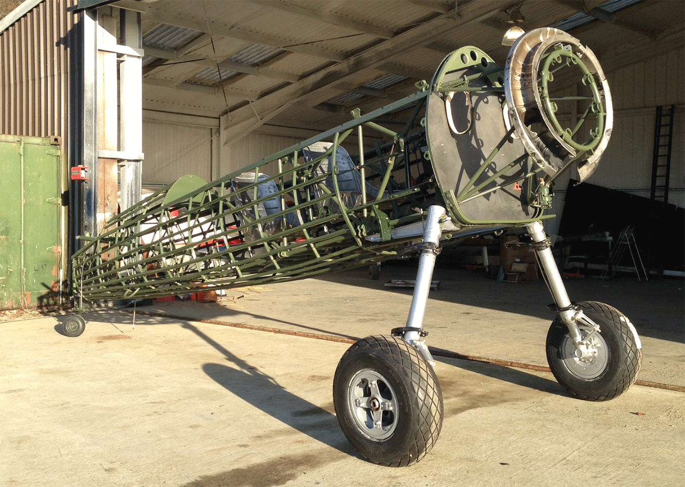
TYPES OF CONSTRUCTION
BOEING PT-17
STEEL

Slide 9
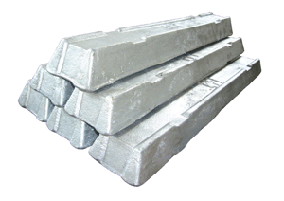
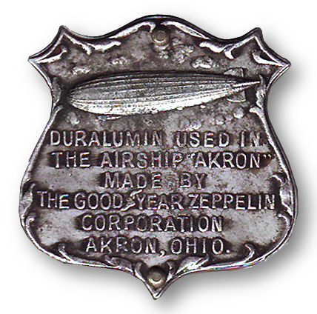
TYPES OF CONSTRUCTION
DURALUMIN
Duralumin is 95% aluminium, 4% copper, 0.5% magnesium, and 0.5% manganese – stronger but more susceptible to corrosion
AN ALUMINUM ALLOY WHICH CONTAINS COPPER
AND MAGNESIUM AND HAS A HIGH TENSILE STRENGTH AND FATIGUE ENDURANCE.
IT IS USED FOR RIBS, FUEL TANKS, BULKHEADS, PROPELLER BLADES, TURBINE BLADES AND FITTINGS.

Slide 10
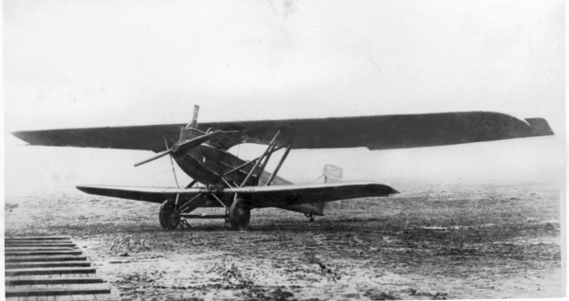
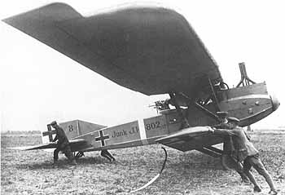
TYPES OF CONSTRUCTION
1917 Junkers J.I / J4
DURALUMIN

Slide 11
TYPES OF CONSTRUCTION
ALCLAD ALUMINUM
A SANDWICH OF DURALUMIN BETWEEN TWO
LAYERS OF PURE ALUMINUM.
RESISTANT TO CORROSION.

Slide 12
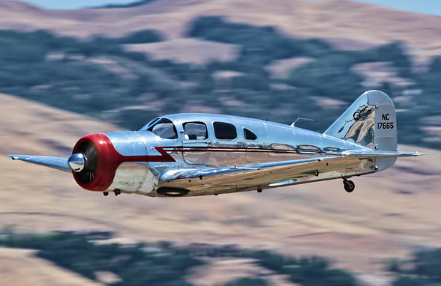
TYPES OF CONSTRUCTION
SPARTAN 7W
ALUMINUM

Slide 13
TYPES OF CONSTRUCTION
MAGNESIUM
HIGH TENSILE STRENGTH, AND VERY LIGHT (1/3 LIGHTER THAN ALUMINUM).
USED IN ENGINE CASE AND WHEEL CONSTRUCTION.
NOT VERY RESISTANT TO CORROSION.

Slide 14
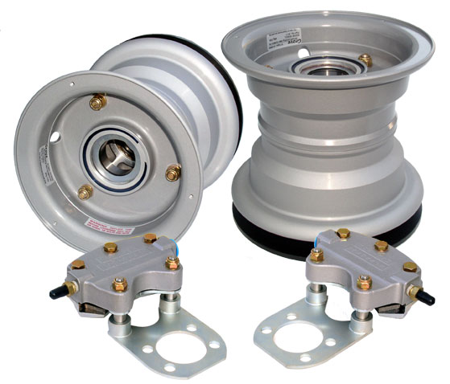
TYPES OF CONSTRUCTION
MAGNESIUM

Slide 15
TYPES OF CONSTRUCTION
HONEYCOMB
A HONEYCOMB PATTERN BETWEEN TWO SHEETS OF ALUMINUM OR COMPOSITES.
HIGH STRENGTH; LIGHT WEIGHT; USED IN CABIN FLOORS AND DOORS.
HEAT DISSIPATION PROPERTIES MAKE IT SUITABLE FOR SKIN STRUCTURES ON SUPERSONIC AIRCRAFT.

Slide 16
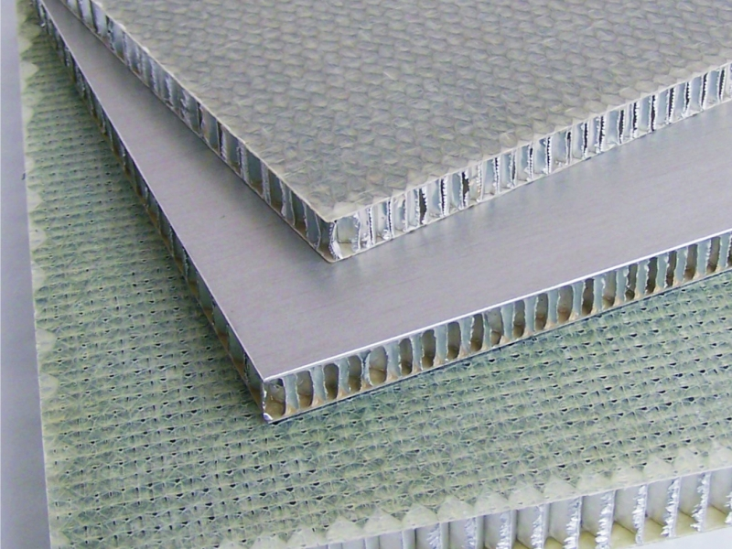
TYPES OF CONSTRUCTION
HONEYCOMB

Slide 17
TYPES OF CONSTRUCTION
COMPOSITE
A SANDWICH CONSTRUCTION OF TWO HIGH-STRENGTH FACE SHEETS EMBEDDED IN A HARDENED EPOXY OR RESIN WITH A LIGHT WEIGHT CORE MATERIAL.
FIBERGLASS, KEVLAR, CARBON FIBER.

Slide 18
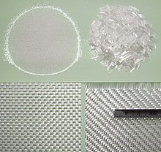
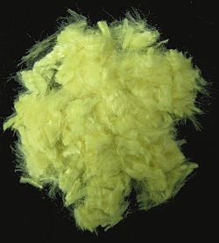
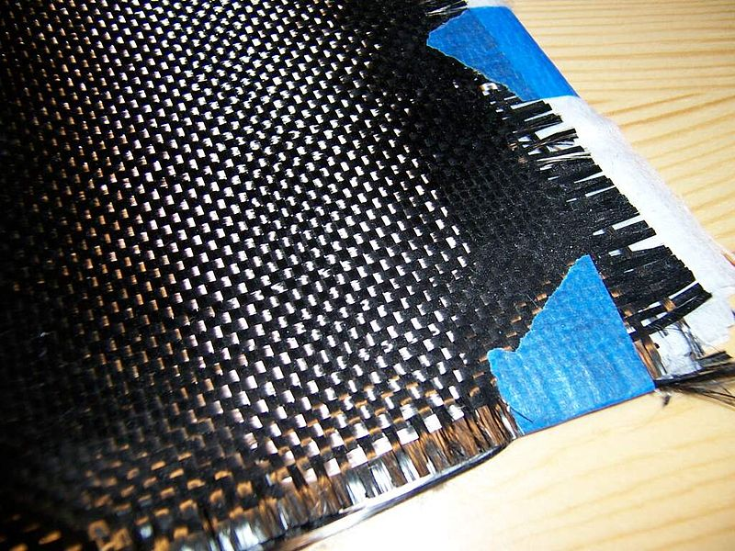
Fiberglass, Kevlar, Carbon Fiber

Slide 19
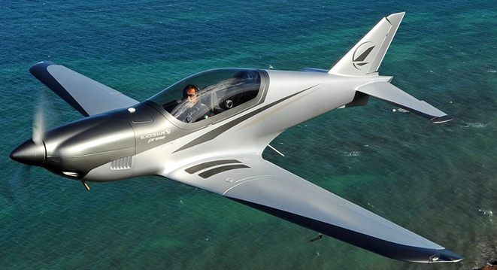
TYPES OF CONSTRUCTION
BLACKSHAPE CF300
COMPOSITE / CARBON FIBER

Slide 20
TYPES OF CONSTRUCTION
CORROSION
OXIDATION
PRODUCED BY MOIST ATMOSPHERIC CONDITIONS, THE EFFECTS ARE WORSE IN THE VICINITY OF SALT WATER.
TREATABLE TO PREVENT FURTHER DAMAGE.

Slide 21
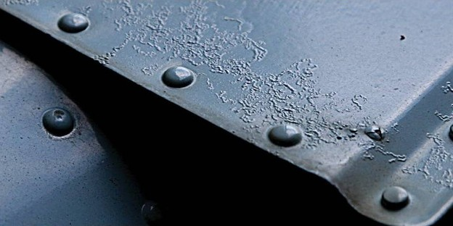
TYPES OF CONSTRUCTION
OXIDIZATION

Slide 22
TYPES OF CONSTRUCTION
CORROSION
INTERCRYSTALLINE
CAUSED BY A CHEMICAL OR ELECTROLYTIC REACTION (GRAIN BOUNDARIES).
DIFFICULT TO DETECT, UNTREATABLE, REQUIRES REMOVAL AND REPLACEMENT.

Slide 23
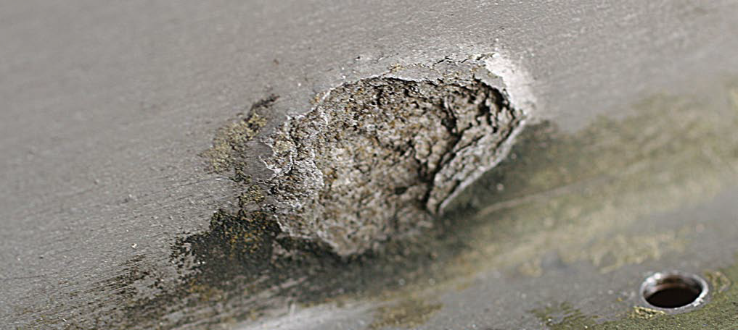
TYPES OF CONSTRUCTION
INTERCRYSTALLINE

Slide 24
TYPES OF CONSTRUCTION
CORROSION
DISSIMILAR METAL / Galvanic Corrosion
WHEN METALS OF DIFFERENT CHEMICAL PROPERTIES ARE IN CONTACT, AND ARE IN THE PRESENCE OF MOISTURE.
THE METAL MOST EASILY OXIDIZED WILL BE SUBJECT TO CORROSION.

Slide 25
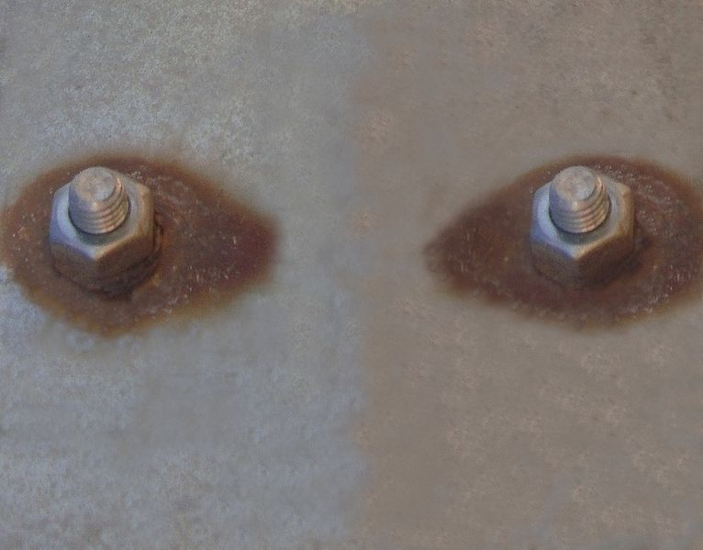
TYPES OF CONSTRUCTION
DISSIMILAR

Slide 26
TYPES OF CONSTRUCTION
CORROSION
STRESS
OVERTIGHTENED NUTS AND HYDRAULIC FITTINGS, OVERTORQUED BOLTS, PRESSED BEARINGS.
DIFFICULT TO DETECT UNTIL A CRACK APPEARS.

Slide 27
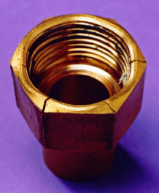
TYPES OF CONSTRUCTION
STRESS

Slide 28
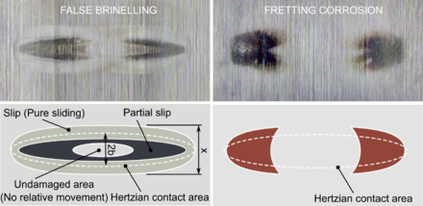
TYPES OF CONSTRUCTION
CORROSION
FRETTING
DUE TO THE SLIGHT MOVEMENT BETWEEN CLOSE FITTED METAL PARTS.
THE MOVEMENT DESTROYS ANY PROTECTIVE FILM AND PRODUCES FINE PARTICLES OF METAL AND OXIDE THAT ABSORB MOISTURE.

Slide 29
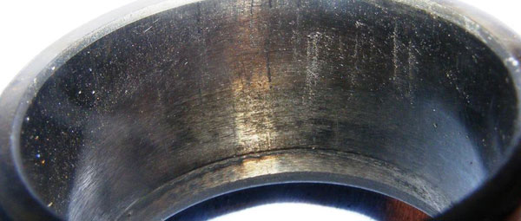
TYPES OF CONSTRUCTION
FRETTING

Slide 30
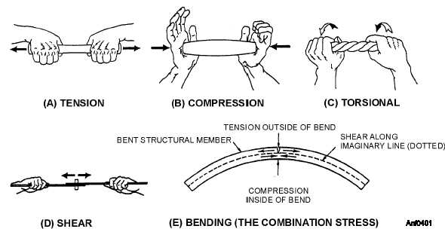
Stresses and Strain

Slide 31
TYPES OF CONSTRUCTION
STRESSES AND STRAIN
COMPRESSION
A “CRUSHING” EFFECT.
AIRCRAFT FUSELAGE AND WINGS ARE SUBJECTED TO COMPRESSION.

Slide 32
TYPES OF CONSTRUCTION
STRESSES AND STRAIN
TENSION
A “STRETCHING” EFFECT.
AIRCRAFT BRACING AND RIGGING ARE SUBJECTED TO TENSION.

Slide 33
TYPES OF CONSTRUCTION
STRESSES AND STRAIN
TORSION
A “TWISTING” OR “BENDING” EFFECT.
AIRCRAFT LANDING GEAR IS SUBJECTED TO TORSION.

Slide 34
TYPES OF CONSTRUCTION
STRESSES AND STRAIN
SHEARING
A “CUTTING” EFFECT.
AIRCRAFT ENGINE MOUNTING BOLTS ARE SUBJECTED TO SHEARING FORCES.

Slide 35
TYPES OF CONSTRUCTION
STRESSES AND STRAIN
BENDING
A “WARPING” EFFECT.
AIRCRAFT WING SPARS ARE SUBJECTED TO BENDING FORCES.

Slide 36
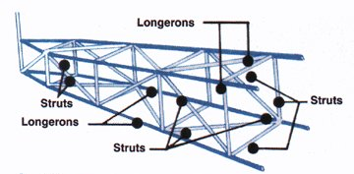
TYPES OF CONSTRUCTION
TUBE & TRUSS
TUBES WELDED TOGETHER TO FORM THE FRAME.
JOINED TRIANGLES – TRUSSES

Slide 37
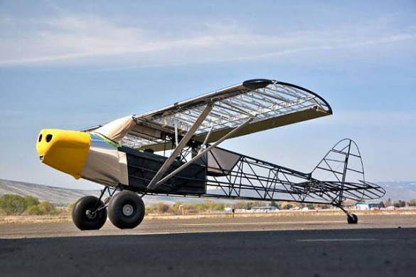
TYPES OF CONSTRUCTION
PIPER SUPER CUB
TUBE & TRUSS

Slide 38
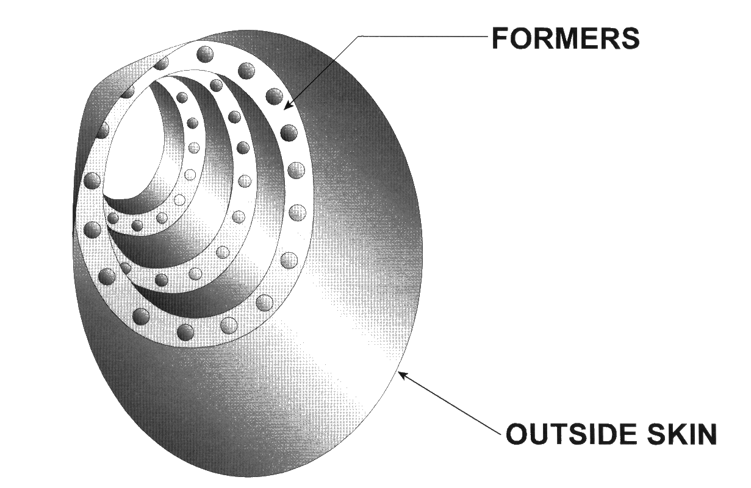
TYPES OF CONSTRUCTION
MONOCOQUE (SHELL ONLY)
STRESSED SKIN STRUCTURE; FORMERS FORM THE SKIN AS DESIRED.

Slide 39
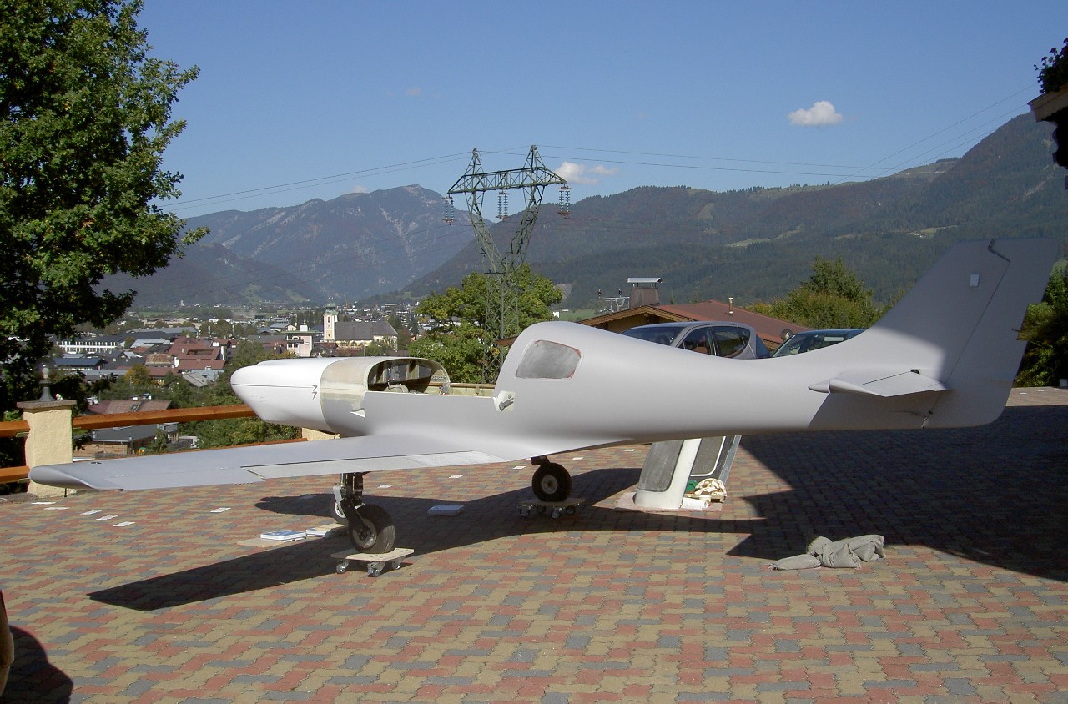
TYPES OF CONSTRUCTION
LANCAIR 360
MONOCOQUE

Slide 40
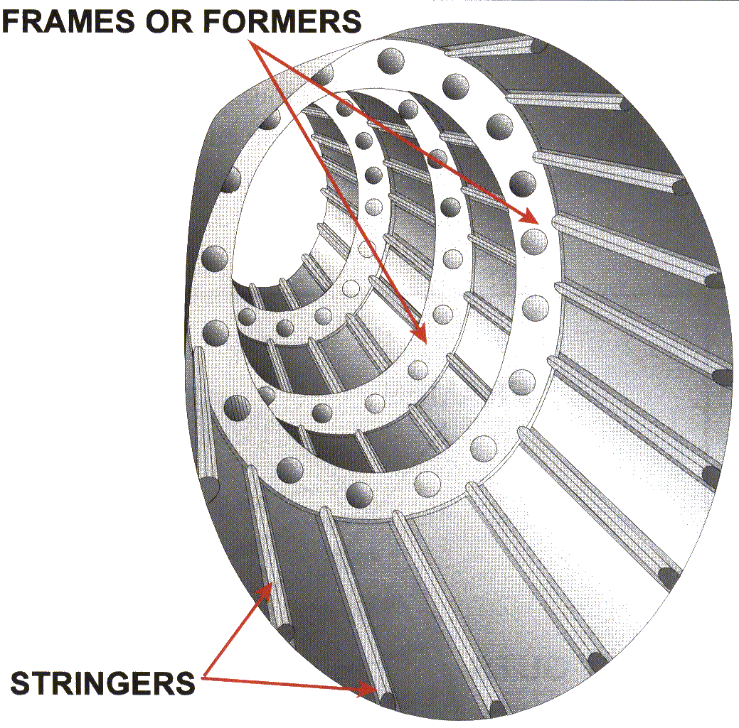
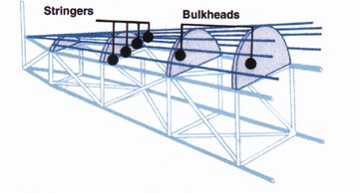
TYPES OF CONSTRUCTION
SEMI-MONOCOQUE
STIFFENERS ADDED TO RESIST PART OF THE LOAD – STRINGERS AND BULKHEADS.

Slide 41
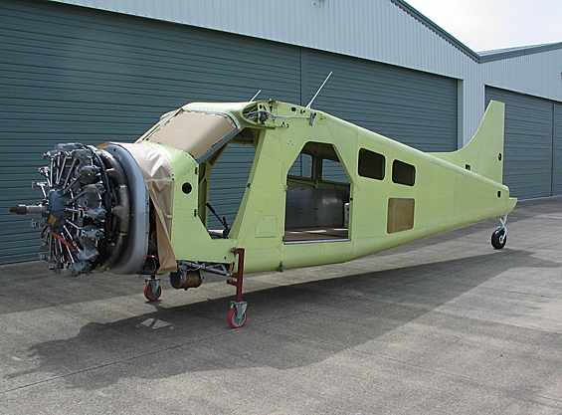
TYPES OF CONSTRUCTION
DHC-2 BEAVER
SEMI-MONOCOQUE

Slide 42
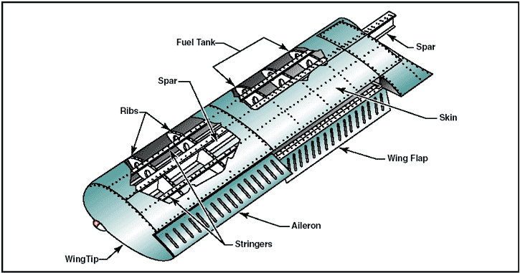
Types of Wing Structures

Slide 43
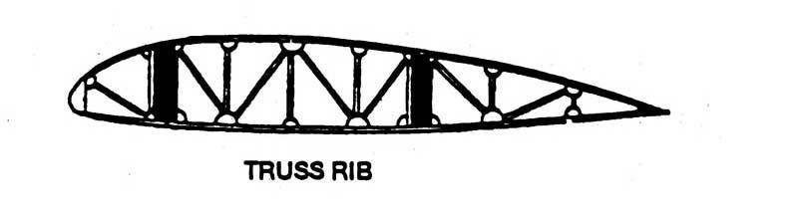
Types of Wing Structures
Truss Rib
Truss type design similar to fuselage
Truss carries the load
Usually is wood and covered with fabric

Slide 44
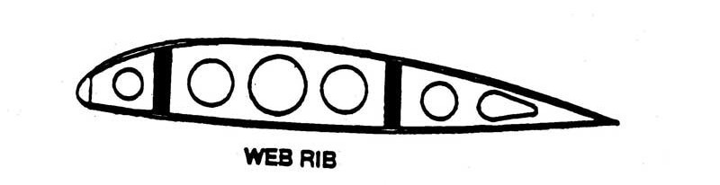
Types of Wing Structures
Web Rib
“semi-monocoque”
Modern design – present in our aircraft
Skin takes part of the load
Holes in the rib make the wing lighter, and provide passages for electrics and control cables

Slide 45
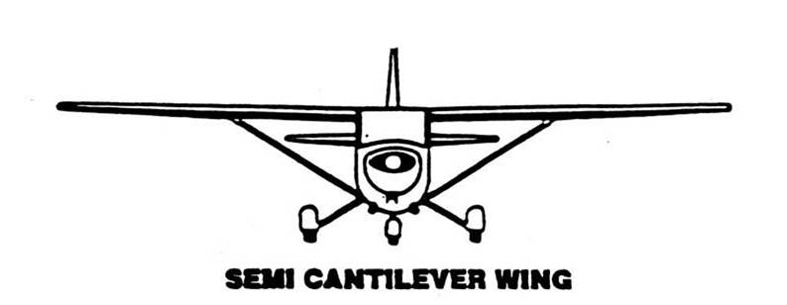
Wings
Semi-Cantilever Wing (wings are supported by struts)
Example: Cessna 172

Slide 46
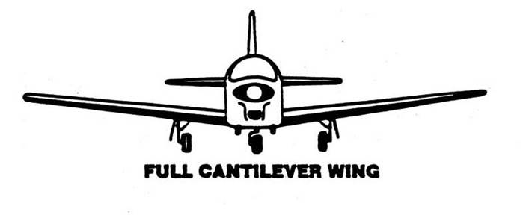
Wings
Full Cantilever Wing (wings are supported by spars only)
Example: Cessna Cardinal, Piper Arrow

Slide 47
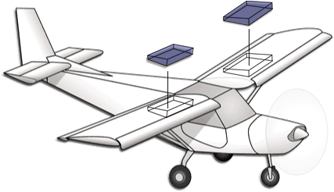
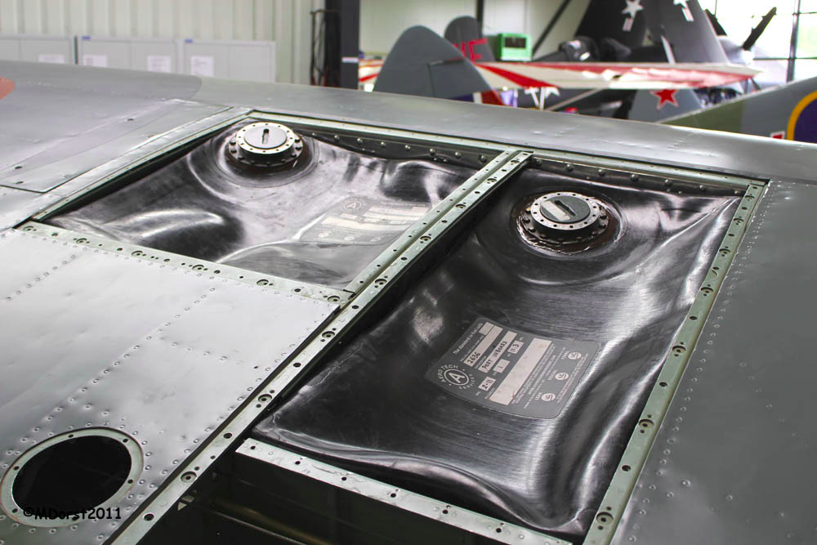
Types of Wing Structures
Wing Tanks
Rigid Removable (removable compartments)
Bladder (reinforced rubber)
Integral (sealed “wet wing”)

Slide 48
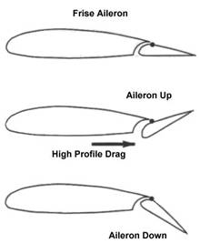
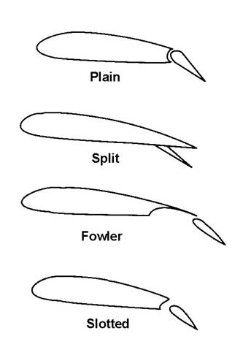
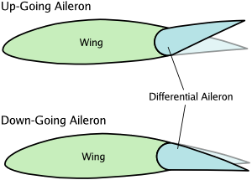
Wing – Ailerons and Flaps
Example: Cessna 172
Slotted Fowler Flaps
Differential Frise Ailerons

Slide 49
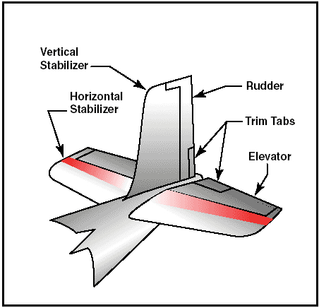
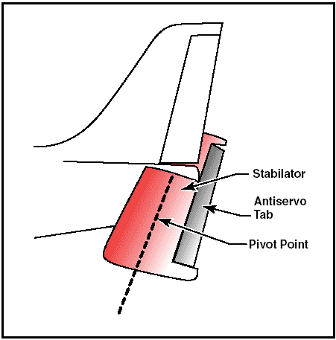
Tail Section – Empenage

Slide 50
LANDING GEAR
TAILWHEEL (CONVENTIONAL)
TWO MAIN WHEELS AHEAD OF THE CENTER OF GRAVITY, AND ONE SMALL WHEEL TO SUPPORT THE TAIL.
TRICYCLE
NOSE WHEEL UP FRONT, AND TWO MAIN WHEELS BEHIND THE CENTER OF GRAVITY.

Slide 51
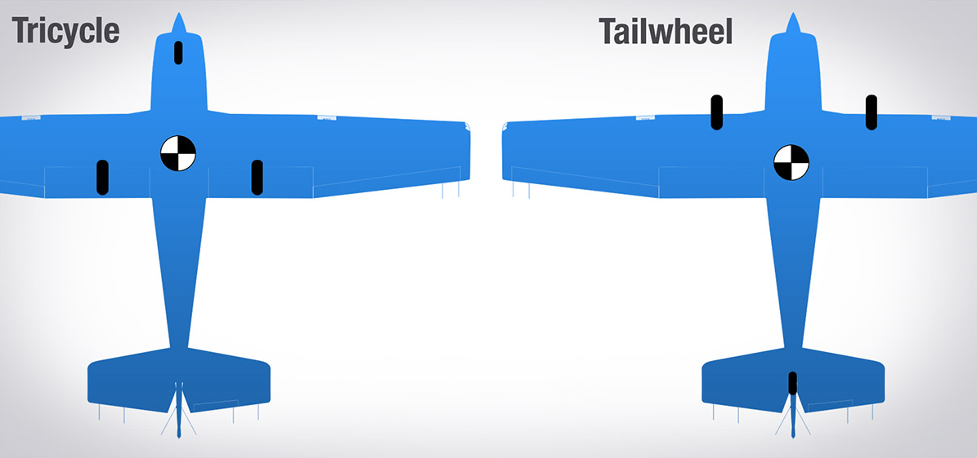
LANDING GEAR

Slide 52
LANDING GEAR
FIXED
THE LANDING GEAR CANNOT RETRACT.
SEMI-RETRACTABLE
THE LANDING GEAR CAN BE PARTIALLY RETRACTED.
RETRACTABLE
THE LANDING GEAR CAN RETRACT INTO THE FUSELAGE AND OR WINGS.

Slide 53
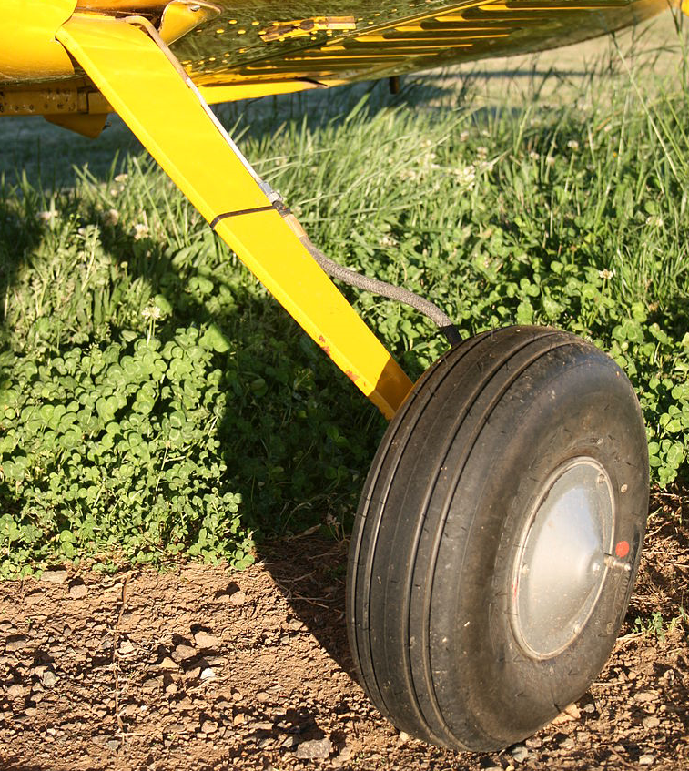
LANDING GEAR
SPRING
GEAR

Slide 54
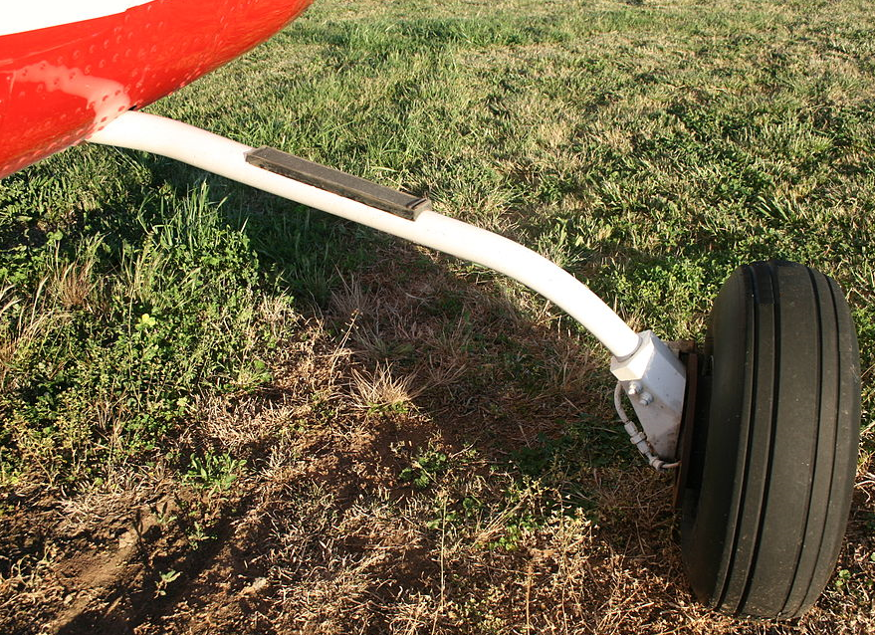
LANDING GEAR
TUBULAR
GEAR

Slide 55
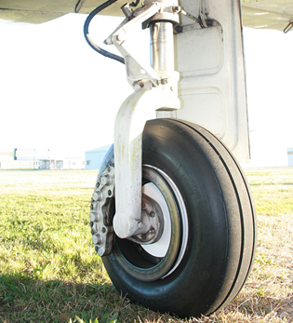
LANDING GEAR
OLEO STRUT
TORQUE LINK

Slide 56
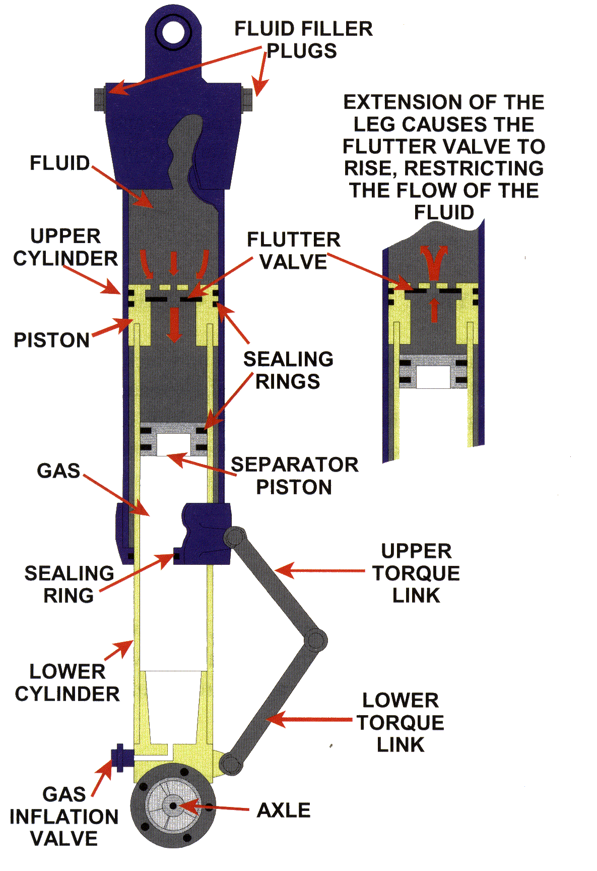
Landing Gear – Oleo Strut

Slide 57
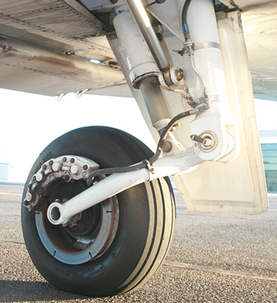
LANDING GEAR
OLEO STRUT
TRAILING LINK

Slide 58
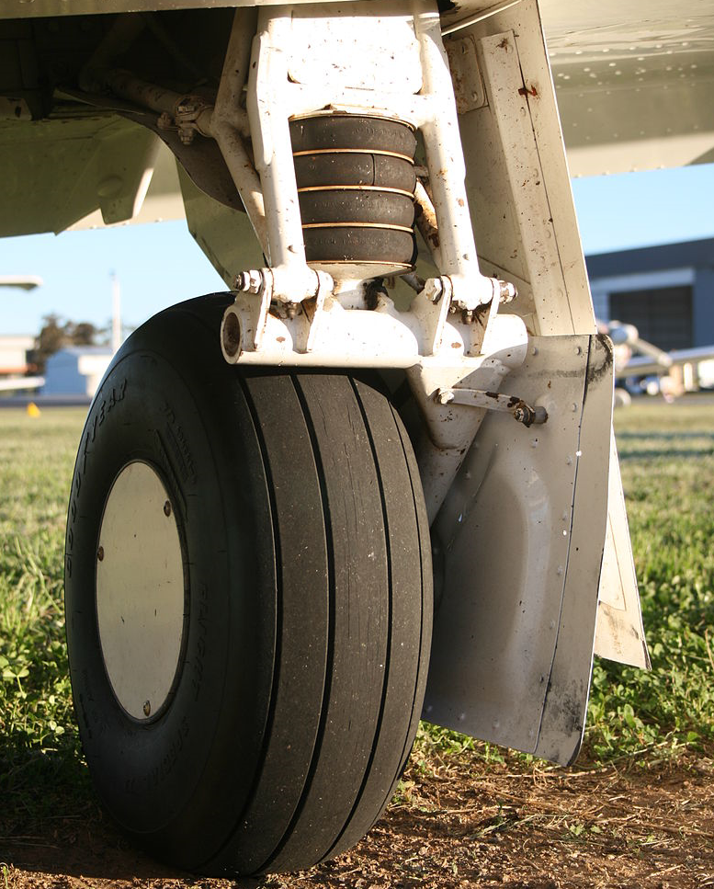
LANDING GEAR
RUBBER DISK
TRAILING LINK

Slide 59
POWER TRANSMISSION
MECHANICAL
THE TRANSMISSION OF POWER THROUGH THE USE OF CABLES, PUSH RODS, TORQUE TUBES, CHAINS AND SPROCKETS.
HYDRAULIC
THE TRANSMISSION OF POWER THROUGH THE USE OF PRESSURIZED LIQUIDS.

Slide 60
POWER TRANSMISSION
PNEUMATIC
THE TRANSMISSION OF POWER THROUGH THE USE OF PRESSURIZED AIR OR INERT GASES.
ELECTRIC
THE TRANSMISSION OF POWER THROUGH THE USE OF ELECTRIFIED MOTORS.

Slide 61


Braking System

Slide 62

ENGINES

Slide 63
ENGINES
TWO STROKE
AN INTERNAL COMBUSTION ENGINE WHICH COMPLETES A POWER CYCLE IN TWO PISTON STROKES (↑ / ↓).
CHAINSAWS / DIRT BIKES / BOATS / ULTRALIGHTS / EXPERIMENTAL-AMATEUR BUILT AIRCRAFT (E-AB).

Slide 64

2-Stroke Combustion

Slide 65
ENGINES
FOUR STROKE
AN INTERNAL COMBUSTION ENGINE WHICH COMPLETES A POWER CYCLE IN 4 PISTON STROKES (↑ / ↓ / ↑ / ↓).
INTAKE → COMPRESSION → POWER → EXHAUST
LAWNMOWERS / MOTORCYCLES / BOATS AUTOMOBILES / ULTRALIGHTS / E-AB / PRODUCTION AIRCRAFT.

Slide 66

4-Stroke Combustion

Slide 67

ENGINES

Slide 68
ENGINES
TYPES
INLINE (STRAIGHT)
RADIAL (ROUND)
HORIZONTALLY OPPOSED (FLAT)
V-TYPE

Slide 69

ENGINES
INLINE ENGINE

Slide 70

ENGINES
INVERTED INLINE GYPSY MAJOR (145 HP)

Slide 71

ENGINES
DHC-1 CHIPMUNK

Slide 72

ENGINES
RADIAL
ENGINE

Slide 73

ENGINES
PRATT & WHITNEY R-1340 (600 HP)

Slide 74

ENGINES
NORTH AMERICAN HARVARD

Slide 75

ENGINES
HORIZONTALLY OPPOSED

Slide 76

ENGINES
CONTINENTAL C-85 (85 HP)

Slide 77

ENGINES
FLEET CANUCK

Slide 78

ENGINES
V-TYPE ENGINE

Slide 79

ENGINES
ROLLS-ROYCE MERLIN (1,710 HP)

Slide 80

ENGINES
DH.98 MOSQUITO

Slide 81
ENGINES
TURBINE
AN INTERNAL COMBUSTION ENGINE WHICH UTILIZES UPSTREAM ROTATING COMPRESSORS AND DOWNSTREAM ROTATING TURBINES SEPARATED BY A COMBUSTION CHAMBER.
BASIC OPERATION IS SIMILAR TO A STEAM POWER PLANT.
E-AB / CORPORATE AIRCRAFT / COMMERCIAL TRANSPORT CATEGORY AIRCRAFT.

Slide 82
ENGINES
TURBINE
TURBOJET
TURBOPROP
TURBOFAN

Slide 83

ENGINES

Slide 84

ENGINES
ORENDA IROQUOIS (25,000 LBS THRUST)

Slide 85

ENGINES
CF-105 AVRO ARROW

Slide 86

ENGINES

Slide 87

ENGINES
GENERAL ELECTRIC
T64 (3,133 HP)

Slide 88

ENGINES
DHC-5 BUFFALO

Slide 89

ENGINES

Slide 90

ENGINES – Turbofan
PW6000 (24,000 LBS THRUST)

Slide 91

ENGINES – Turbofan

Slide 92

ENGINES
AIRBUS A320

Slide 93
ENGINES
METHODS OF COOLING
LIQUID COOLED:
PROVIDE LESS HAZARD OF SHOCK-COOLING, MORE COMPLEX, ADDS EXTRA WEIGHT.
AIR COOLED:
GREATER HAZARD OF SHOCK-COOLING, LESS COMPLEX, LESS WEIGHT.

Slide 94
ENGINES
MAGNETO
AN ENGINE DRIVEN ELECTRICAL GENERATOR THAT USES PERMANENT MAGNETS AND COILS TO PRODUCE HIGH VOLTAGE TO FIRE THE AIRCRAFT’S SPARK PLUGS.

Slide 95

ENGINES

Slide 96
ENGINES
DUAL IGNITION
TWO SPARK PLUGS IN EACH CYLINDER, TWO MAGNETOS GEARED TO THE ENGINE.
ONE MAGNETO FIRES ONE SPARK PLUG, THE OTHER FIRES THE SECOND SPARK PLUG.
REDUNDANCY AND IMPROVED COMBUSTION INCREASING POWER AND IMPROVING PERFORMANCE.

Slide 97

IGNITION SYSTEM – MAGNETOS

Slide 98

ENGINES

Slide 99
ENGINES
EXHAUST SYSTEM
A SCAVENGING SYSTEM THAT COLLECTS
AND DISPOSES OF HIGH TEMPERATURE, NOXIOUS GASES DISCHARGED FROM THE ENGINE.
THE MAIN FUNCTION IS TO PREVENT THE ESCAPE OF DESTRUCTIVE GAS INTO THE AIRFRAME AND CABIN.

Slide 100
ENGINES
EXHAUST SYSTEM
SHORT STACK:
EACH CYLINDER HAS AN EXHAUST STACK WHICH IS ROUTED TO A MANIFOLD AND THEN DIRECTED OUT THROUGH ONE OR TWO EXHAUST STACKS.

Slide 101
ENGINES
EXHAUST SYSTEM
COLLECTOR SYSTEM:
INDIVIDUAL EXHAUST HEADERS EMPTY INTO A COLLECTOR RING AND ARE DIRECTED THROUGH A TURBOCHARGER PRIOR TO BEING DIRECTED OUT THROUGH THE EXHAUST STACKS.

Slide 102
ENGINES
EXHAUST SYSTEM
CABIN HEAT:
A SHROUD ENCIRCLES THE MANIFOLD OR COLLECTOR RING.
AIR PASSING THROUGH THE SHROUD IS THEN HEATED AND DIRECTED TO THE CABIN TO PROVIDE CABIN HEAT.

Slide 103
ENGINES
AIR DENSITY EFFECTS
ATMOSPHERIC DENSITY DECREASES WITH A GAIN IN ALTITUDE.
THE ATMOSPHERE IS HALF AS DENSE AT 18,000’ AS IT IS AT SEA LEVEL.
HUMIDITY DECREASES ATMOSPHERIC DENSITY.

Slide 104

ENGINES

Slide 105

ENGINES

Slide 106
ENGINES
AIR DENSITY EFFECTS
NORMALLY ASPIRATED:
AIR INTAKE DEPENDS SOLELY UPON ATMOSPHERIC PRESSURE.
FORCED INDUCTION:
INTAKE AIR IS COMPRESSED AND INCREASED USING A SUPERCHARGER OR A TURBOCHARGER.

Slide 107
ENGINES
SUPERCHARGER
A MECHANICALLY (BELT / GEAR / SHAFT / CHAIN) DRIVEN COMPRESSOR POWERED BY THE ENGINE.
THE COMPRESSOR IS INSTALLED DOWNSTREAM OF THE CARBURETOR
(FUEL SERVO) COMPRESSING THE
FUEL : AIR MIXTURE AFTER IT LEAVES THE CARBURETOR (FUEL SERVO).

Slide 108
ENGINES
SUPERCHARGER
APPROXIMATELY 16% OF THE ENGINE’S POWER DRIVES THE COMPRESSOR.
PRESSURIZED FUEL : AIR DELIVERED TO THE MANIFOLD IS KNOWN AS BOOST.

Slide 109

ENGINES

Slide 110

ENGINES
SUPERCHARGER

Slide 111
ENGINES
TURBOCHARGER
AN EXTERNALLY DRIVEN COMPRESSOR POWERED BY ENGINE EXHAUST GAS
TURBINE IMPELLER.
INSTALLED UPSTREAM OF THE
CARBURETOR (FUEL SERVO) IT
COMPRESSES THE AIR PRIOR TO BEING MIXED (METERED) WITH THE FUEL IN THE CARBURETOR (FUEL SERVO).

Slide 112
ENGINES
TURBOCHARGER
A WASTE GATE REGULATES HOW MUCH EXHAUST GAS IS DIRECTED THROUGH
THE TURBINE IMPELLER.
WHEN THE WASTE GATE IS OPEN, THE ENGINE IS NORMALIZED; WHEN THE WASTEGATE IS CLOSED, THE ENGINE IS TURBOCHARGED.

Slide 113
ENGINES
TURBOCHARGER
THE WASTE GATE CAN BE MANUALLY
OR AUTOMATICALLY CONTROLLED.
TURBO LAG IS THE TIME INTERVAL
BETWEEN THE THROTTLE BEING
OPENED AND THE TURBOCHARGER PROVIDING INCREASED INTAKE
PRESSURE.

Slide 114

ENGINES

Slide 115

ENGINES
TURBO CHARGER

Slide 116
ANCILLARY CONTROLS
THROTTLE
CONTROLS ENGINE RPM IN AN AIRCRAFT WITH A FIXED PITCH PROPELLER.
CONTROLS ENGINE MANIFOLD PRESSURE
IN AN AIRCRAFT WITH A CONSTANT SPEED PROPELLER.

Slide 117

ANCILLARY CONTROLS
THROTTLE

Slide 118
ANCILLARY CONTROLS
PROPELLER
CONTROLS ENGINE RPM IN AN AIRCRAFT WITH A CONSTANT SPEED PROPELLER.
IN – FINE / OUT – COARSE.

Slide 119
ANCILLARY CONTROLS
PROPELLER

Slide 120
ANCILLARY CONTROLS
MIXTURE
ADJUSTS THE MIXTURE CONTROL TO THE CARBURETOR / FUEL SERVO.
EGT / TIT
IN – RICH / OUT – LEAN (IDLE CUT-OFF).

Slide 121
ANCILLARY CONTROLS
MIXTURE

Slide 122
ANCILLARY CONTROLS
FLAPS
ADJUSTS FLAP DEFLECTION.
10° - 30°

Slide 123
ANCILLARY CONTROLS
FLAP

Slide 124
ANCILLARY CONTROLS
COWL FLAPS
OPENS COWL FLAPS TO INCREASE
ENGINE COOLING.
CLOSES COWL FLAPS TO DECREASE
ENGINE COOLING.

Slide 125
ANCILLARY CONTROLS
COWL
FLAP

Slide 126
ANCILLARY CONTROLS
ELEVATOR TRIM
TRIMS THE ELEVATOR UP
TRIMS THE ELEVATOR DOWN

Slide 127
ANCILLARY CONTROLS
ELEVATOR
TRIM

Slide 128
ANCILLARY CONTROLS
RUDDER TRIM
TRIMS THE RUDDER LEFT
TRIMS THE RUDDER RIGHT

Slide 129
ANCILLARY CONTROLS
RUDDER
TRIM

Slide 130
GAUGES
AIRCRAFT SYSTEMS
A PILOT MUST DIVIDE THEIR ATTENTION BETWEEN FLYING THE AIRCRAFT
AND MONITORING AIRCRAFT FLIGHT INSTRUMENTS.

Slide 131
GAUGES
FUEL GAUGES
FUEL QUANTITIES (US GALLONS)
LEFT & RIGHT FUEL TANKS

Slide 132

GAUGES
FUEL

Slide 133
GAUGES
TEMP & PRESS
OIL TEMPERATURE (°F)
OIL PRESSURE (PSI)

Slide 134

GAUGES
TEMP
PRESS

Slide 135
GAUGES
EGT / TIT & CHT
EXHAUST GAS TEMPERATURE (EGT) °F ~ REGULATED BY MIXTURE CONTROL.
TURBINE INLET TEMPERATURE (TIT) °F ~ REGULATED BY MIXTURE CONTROL.
CYLINDER HEAD TEMPERATURES (CHT) °F ~ REGULATED BY COWL FLAPS.

Slide 136
GAUGES
EGT / TIT
CHT

Slide 137
GAUGES
VAC & AMP
VACUUM SYSTEM PRESSURE (“Hg).
FLOW RATE OF ELECTRICAL SYSTEM AMPERAGE (AMPS).

Slide 138
GAUGES
VAC
AMP

Slide 139
GAUGES
MANIFOLD PRESSURE
INDICATES THE ENGINE’S
INTAKE VACUUM PRESSURE (“Hg).

Slide 140

GAUGES
MAN
PRESS

Slide 141
GAUGES
FUEL FLOW
INDICATES THE FLOW OF FUEL
THROUGH THE FLOW DISTRIBUTION
VALVE (GPH).

Slide 142
GAUGES
FUEL
FLOW

Slide 143
GAUGES
TACHOMETER
MONITORS THE ENGINE’S
CRANK SHAFT / PROPELLER
REVOLUTION PER MINUTE (RPM).

Slide 144
GAUGES
TACH

Slide 145
CARBURETOR
MEASURES THE CORRECT QUANTITY
OF FUEL, VAPORIZES IT AND MIXES IT WITH THE PROPER PROPORTION OF AIR TO BE DELIVERED TO THE ENGINE.
THE RATIO OF FUEL IS REGULATED BY
THE MIXTURE CONTROL.
THE THROTTLE REGULATES THE FLOW OF AIR TO THE ENGINE.

Slide 146

CARBURETOR

Slide 147

CARBURETOR
CARBURETOR

Slide 148
CARBURETOR
ICING
THE CARBURETOR IS SUSCEPTIBLE
TO ICING UNDER MOIST ATMOSPHERIC CONDITIONS.
ICE WHICH FORMS DUE TO THE DROP
IN TEMPERATURE DURING THE
VAPORIZATION OF FUEL IS KNOWN AS VAPORIZATION ICE.

Slide 149
CARBURETOR
ICING
ICE WHICH FORMS FROM THE COOLING
DUE TO THE DECREASE IN PRESSURE
IN THE CARBURETOR IS KNOWN AS THROTTLE ICE.
INDICATED BY A LOSS IN POWER (RPM)
FOR AN AIRCRAFT WITH A FIXED PITCH PROPELLER.

Slide 150
CARBURETOR
ICING
INDICATED BY A DECREASE IN MANIFOLD PRESSURE (MP) FOR AN AIRCRAFT WITH
A CONSTANT SPEED PROPELLER.
CARB ICING CAN CAUSE A COMPLETE ENGINE FAILURE.

Slide 151

CARBURETOR
THROTTLE ICE

Slide 152

CARBURETOR

Slide 153

CARBURETOR

Slide 154

CARBURETOR
WHILE CARB ICING CAN OCCUR AT ANY TEMPERATURE,
THE MOST SERIOUS ICING OCCURS BETWEEN:
-5° C TO +15° C

Slide 155
CARBURETOR
CARB HEAT
THE BEST WAY TO PREVENT CARB ICING
IS TO UTILIZE CARB HEAT AT REGULAR INTERVALS DURING THE FLIGHT.
ALWAYS UTILIZE CARB HEAT DURING DESCENTS, OR WHEN THE POWER IS
SET OUT OF THE GREEN ARC ON THE TACHOMETER.
AVOID PROLONGED USE OF CARB HEAT
ON THE GROUND AS THE AIR IS
UNFILTERED.

Slide 156
CARBURETOR
CARB HEAT
BECAUSE WARM AIR IS LESS DENSE,
THE MIXTURE WILL BECOME RICHER WHEN CARB HEAT IS ON RESULTING IN SLIGHT
LOSS OF POWER.
CARB HEAT SHOULD BE OFF DURING TAKEOFF TO PROVIDE FULL POWER AND
TO AVOID DETONATION.

Slide 157
CARBURETOR
CARB ICE
ICE WHICH BUILDS UP ON THE INTAKE
SCOOP OR AIR FILTER DUE TO SNOW,
SLEET OR SUPERCOOLED
WATER DROPLETS.
THE USE OF CARB HEAT; MANUAL OR AUTOMATIC ALTERNATE AIR WILL
RESTORE ADEQUATE AIRFLOW.

Slide 158
FUEL INJECTION
FUEL SERVO (FUEL INJECTION)
METERS THE CORRECT QUANTITY OF
FUEL TO THE PROPER PROPORTION OF
AIR BASED ON THE THROTTLE AND
MIXTURE SETTING, BUT DOES NOT MIX THEM.
AIR IS DIRECTED TO THE INTAKE MANIFOLD.
FUEL IS DIRECTED TO THE FLOW DISTRIBUTION VALVE WHICH DIRECTS
THE FUEL TO THE INJECTORS IN THE CYLINDERS.

Slide 159

FUEL INJECTION
FUEL
SERVO

Slide 160
CARBURETED VS. FUEL INJECTION
CARBURETED:
INEXPENSIVE
MORE RESISTANT TO
FUEL CONTAMINATION
SUSCEPTIBLE TO ICING
LESS EFFICIENT
POOR FUEL : AIR DISTRIBUTION
FUEL INJECTED:
EXPENSIVE
SUSCEPTIBLE TO FUEL CONTAMINATION
NOT SUSCEPTIBLE TO ICING
MORE EFFICIENT
GOOD FUEL : AIR DISTRIBUTION

Slide 161
MIXTURE CONTROL
MIXTURE CONTROL
MIXTURE MUST BE LEANED WHEN
FLYING AT HIGHER ALTITUDES.
MIXTURE MUST BE ENRICHED WHEN
FLYING AT LOWER ALTITUDES.

Slide 162
MIXTURE CONTROL
MIXTURE CONTROL
THE FUEL : AIR RATIO IS GOVERNED
BY WEIGHT AND NOT BY VOLUME.
BEST POWER = 1:14
BEST ECONOMY = 1:15

Slide 163
MIXTURE CONTROL
MIXTURE CONTROL
RICHER MIXTURES → HIGHER POWER SETTINGS
LEANER MIXTURES → CRUISE POWER SETTINGS

Slide 164
LUBRICATING SYSTEM
OIL
A LUBRICANT FOR INTERNAL COMBUSTION ENGINES HAS FOUR BASIC FUNCTIONS:
COOLING; SEALING; LUBRICATING; FLUSHING
THE REQUIREMENTS FOR OIL ARE:
VISCOSITY; HIGH FLASH POINT;
LOW CARBON CONTENT; LOW POUR POINT

Slide 165
LUBRICATING SYSTEM
OIL
COOLING – CARRIES AWAY HEAT CREATED
BY THE ENGINE.
SEALING – PROVIDES A SEAL BETWEEN
PISTON RINGS AND CYLINDER WALLS.
LUBRICATION – MAINTAINS AN OIL FILM
BETWEEN MOVING PARTS AVOIDING METAL
ON METAL CONTACT.
FLUSHING – CLEANS AND FLUSHES THE
INTERIOR OF THE ENGINE OF CONTAMINANTS.

Slide 166
LUBRICATING SYSTEM
OIL
VISCOSITY = RESISTANCE TO FLOW
HIGH VISCOSITY = FLOWS LIKE HONEY
LOW VISCOSITY = FLOWS LIKE WATER
HIGH VISCOSITY IS USED IN HOT CLIMATES
(HIGHER OIL PRESSURE RESULTS IF USED IN COLD CLIMATES)
LOW VISCOSITY IS USED IN COLD CLIMATES
(LOWER OIL PRESSURE RESULTS IF USED IN WARM CLIMATES)

Slide 167
LUBRICATING SYSTEM
OIL
HIGH FLASH POINT – THE TEMPERATURE
BEYOND WHICH A FLUID WILL IGNITE.
THIS SHOULD BE WELL IN EXCESS OF THE
HIGHEST ENGINE TEMPERATURE.

Slide 168
LUBRICATING SYSTEM
OIL
LOW CARBON CONTENT – LEAVE AS LITTLE CARBON AS POSSIBLE SHOULD OIL MAKE IT
PAST THE SCRAPER RING AND BURN.
OILS WHICH RESIST DETERIORATION AND THE FORMATION OF CARBON DEPOSITS HAVE
GOOD “OXIDATION STABILITY”.

Slide 169
LUBRICATING SYSTEM
OIL
LOW POUR POINT – THE TEMPERATURE AT
WHICH OIL BECOMES SEMI SOLID AND LOSES
ITS FLOW CHARACTERISTICS.
ENGINES MUST BE PRE-HEATED IN COLD
CLIMATES TO ENSURE ADEQUATE POUR POINT PRIOR TO ENGINE START UP.

Slide 170
LUBRICATING SYSTEM
OIL GRADING
OIL IS GRADED USING A S.A.E. NUMBER TO INDICATE ITS VISCOSITY.
(SOCIETY OF AUTOMOTIVE ENGINEERS)
HIGH VISCOSITY OIL = HIGH S.A.E. NUMBER
LOW VISCOSITY OIL = LOW S.A.E. NUMBER

Slide 171
LUBRICATING SYSTEM
OIL GRADING
S.A.E. 60 - SUMMER
S.A.E. 50 - FALL / SPRING
S.A.E. 40 - WINTER
S.A.E. 30 - ARCTIC

Slide 172
LUBRICATING SYSTEM
OIL TYPES
TWO TYPES OF OIL CAN BE USED IN AIRCRAFT COMBUSTION ENGINES:
MINERAL
ASHLESS DISPERSANT (A.D.)

Slide 173
LUBRICATING SYSTEM
MINERAL OIL
IS USED DURING THE ENGINE BREAK-IN
PERIOD TO HELP SEAT THE COMPRESSION
RINGS.
HAS LESS LUBRICITY THAN A.D. OIL WHICH PROVIDES INCREASED FRICTION FOR THE “SEATING” THE RINGS.

Slide 174
LUBRICATING SYSTEM
A.D. OIL
ASHLESS DISPERSANT OIL HAS ADDITIVES
WHICH SUSPEND CARBON AND DEBRIS
FROM INSIDE THE ENGINE AND CARRY THEM
TO THE OIL FILTER.
A.D. OIL TURNS BLACK WITHIN THE FIRST
FEW HOURS OF USE.

Slide 175
LUBRICATING SYSTEM
METHODS OF LUBRICATION
FORCE FEED – OIL PUMPED THROUGH A
HOLLOW CRANKSHAFT WHERE IT LUBRICATES
THE BEARINGS AND IS SPRAYED AS A MIST TO LUBRICATE THE RAMAINING PARTS OF THE ENGINE.
SPLASH – OIL IS CHURNED BY THE CRANKSHAFT INTO A HEAVY MIST THAT SPLASHED OVER VARIOUS PARTS OF THE ENGINE.

Slide 176
LUBRICATING SYSTEM
METHODS OF LUBRICATION
DRY SUMP – OIL IS PUMPED FROM A SEPARATE
OIL RESERVOIR INTO THE ENGINE UNDER PRESSURE AND IS RETURNED FROM A SUMP THROUGH AN OIL COOLER BACK INTO THE RESERVOIR.
WET SUMP – OIL IS PUMPED FROM A SUMP UNDER THE ENGINE THROUGH THE ENGINE GALLERIES AND CRANKSHAFT; THROUGH AN OIL COOLER; AND RETURNED TO THE OIL SUMP BY GRAVITY.

Slide 177

DRY SUMP LUBRICATION

Slide 178
LUBRICATING SYSTEM
VENTING
CRANKCASES MUST BE VENTED TO ALLOW FOR MOISTURE AND GASES TO ESCAPE FROM THE ENGINE.
“BLOW-BY” IS THE LEAKAGE OF THE FUEL:AIR MIXTURE OR EXHAUST GASES PAST THE PISTON RINGS INTO THE CRANK CASE.
VENTING PREVENTS PRESSURE FROM BUILDING UP IN THE CRANK CASE.

Slide 179
LUBRICATING SYSTEM
OIL COOLER
MAINTAINS OIL TEMPERATURE WHILE THE ENGINE IS RUNNING.
HOT OIL REQUIRING COOLING IS ROUTED THROUGH THE COOLER; THEN BACK THROUGH AN OIL FILTER; THEN TO A PRESSURE RELEIF VALVE BEFORE BEING CIRCULATED THROUGH THE ENGINE.
OIL THAT DOES NOT REQUIRE COOLING IS ROUTED DIRECTLY TO THE FILTER AND PRESSURE RELIEF VALVE BY A THERMOSTATIC BYPASS VALVE.

Slide 180

LUBRICATING SYSTEM
OIL
COOLER

Slide 181
LUBRICATING SYSTEM
FILTERS
OIL FILTERS ARE DESIGNED TO FILTER CONTAMINANTS FROM INSIDE THE ENGINE.
SPIN-ON FULL-FLOW OIL FILTERS ARE CUT
OPEN WHEN THE OIL IS CHANGED TO INSPECT FOR METAL FILINGS.

Slide 182

LUBRICATING SYSTEM
OIL FILTER

Slide 183

LUBRICATING SYSTEM
OIL FILTER CUTTER

